Slide 1

Operating Systems Design( 19CS2106S) Session-6 Low-Level File System Algorithms (Internal Representation of Files)
Text Book- The Design of the UNIX Operating System
--------------------Marice J.Bach

Slide 2
Review of Session-4
Session-4 deals about Buffer Cache.
Buffer Cache is small area in Main Memory(RAM).
Similar to Cache Memory.
Its purpose is to temporarily store the frequently accessed Blocks from Disk Memory (Secondary Memory) into the Buffers of the Buffer Cache by the Kernel.
That means, before allocating the buffers/blocks to various processes , the kernel keeps these disks blocks temporarily inside the buffers of this buffer cache.
In Buffer Cache, there are components like Buffer Header, and the other area where the buffers actually located in Hash Queues & Free Lists.

Slide 3
Review of Session-4
Buffer Header consists of various fields like device number, block number, status and various pointer fields
By default, the kernel stores the disk blocks in the buffers of Hash Queues.
These buffers will be allocated to various processes by the Kernel from time to time depending on the requirement.
The Hash Queue stores functions based on a Hash function and this hash function is a device number mod block number combination

Slide 4
Review of Session-4
So, the blocks are mainly stored in Hash Queue buffers and these buffers the kernel allocates to various processes.
But all the buffers stored in the HQs will not be allocated to processes, and few buffers will NOT be allocated to any processes and will be left FREE.
These freely available blocks will be kept separately in a data structure called FREE LIST.

Slide 5
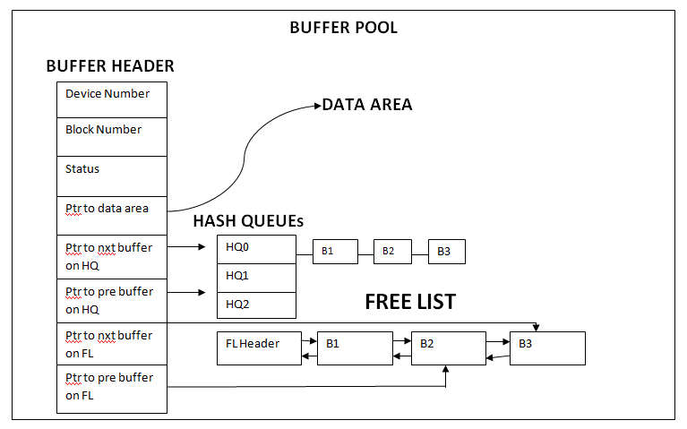
Buffer Cache-Micro View

Slide 6
Review of Session-4-FIVE SCENARIOS
While allocating the buffer blocks to various processes, the kernel faces FIVE different scenarios

Slide 7
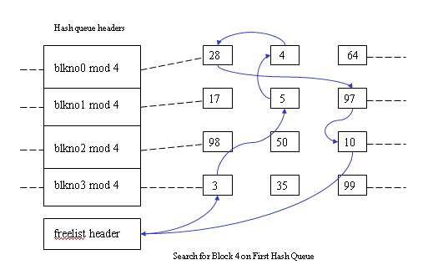
Scenario-1

Slide 8
1st Scenario-After Allocation
After allocating
Blkno 0 mod 4
64
28
4
Blkno 1 mod 4
17
97
5
Blkno 2 mod 4
98
50
10
Blkno 3 mod 4
3
35
99
Freelist header
(b) Remove block 4 from free list

Slide 9
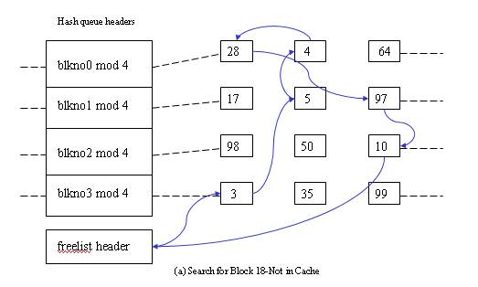
Scenario-2

Slide 10
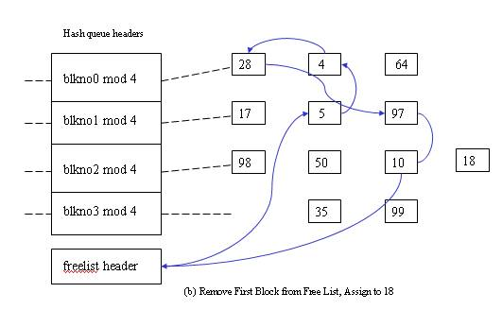
Scenario-2-After Allocation

Slide 11
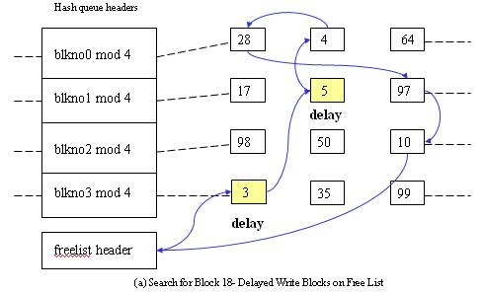
Scenario-3-with Delayed Write Buffers

Slide 12
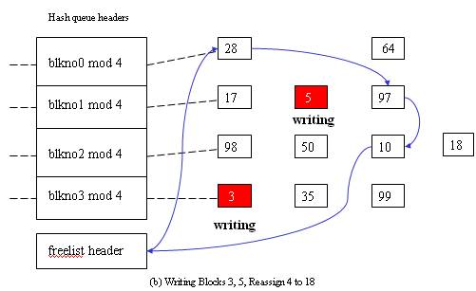
Scenario-3-After the Allocation

Slide 13
What is Delayed-Write ?
It is mechanism of Kernel, intentionally delaying the write operation of a buffer block for some time , to increase the performance and throughput.
Normally, the kernel has to perform the write operation synchronously twice i.e first in disk block and then in the buffer block.
But here, the kernel after performing the write operation ,it delays/postpones the write operation on the buffer block intentionally , to speed up the operation.
After some time, the kernel performs the write operation on the buffer block.

Slide 14
For a buffer block, if the write operation is delayed or pending, it SHOULD NOT be allocated to any process, till the write operation completes.

Slide 15
4th Scenario
Nothing in the hash queue and no free buffer
Wait until any buffer free and re-do
Blkno 0 mod 4
Blkno 1 mod 4
Blkno 2 mod 4
Blkno 3 mod 4
 |  | 28 |  | 4 |  | 64
 |  | 17 |  | 5 |  | 97
 |  | 98 |  | 50 |  | 10
 |  | 3 |  | 35 |  | 99
Freelist header
(a) Search for block 18, empty free list

Slide 16
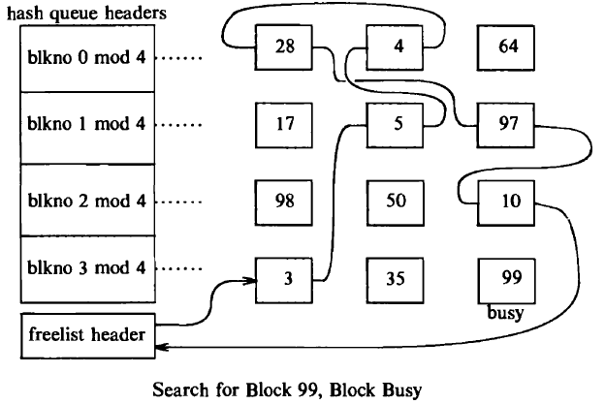
Scenario-5

Slide 17
Text Book
The Design of UNIX Operating System
----Marice J.Bach

Slide 18
Review of Session-5-Buffer Cache Algorithms
1.brelse
2.getblk
3.bread
4.breada

Slide 19
Review of Session 5:brelse
When a buffer block is allocated to a process lets say, P1 ,by the kernel, that buffer block is marked as busy, so that it can not be accessed by any other process.
If any other processes tries to access that buffer block, it will NOT be available for those processes because its marked busy
Now all those processes will go to sleep mode.
Once that process P1 completes its hold on that buffer block, then the kernel releases that buffer block from the process P1, using this algorithm brelse.
That released buffer block is placed at end of the FREE LIST.
Now the kernel awakens the sleeping processes and allocates the buffer blocks.

Slide 20
Review of Session 5: getblk
Used for Buffer Allocation.
When about to read data from a particular disk block, the kernel checks whether the block is in the buffer pool and, if it is not there, assigns it a free buffer.
When about to write data to a particular disk block, the kernel checks whether the block is in the buffer pool, and if not, assigns a free buffer for that block.
The algorithms for reading and writing disk blocks use the algorithm getblk to allocate buffers from the pool.
Five Scenarios can be understood

Slide 21
Review of Session 5-bread & breada
bread stands for block read.
This algorithm is used to read a disk block.
breada stands for block read ahead.
This algorithm also used for disk block reading but with a small difference.
That is, bread is used for simple read operation of a single disk block where as breada is used for asynchronous reading of TWO disk blocks one after the other.

Slide 22
Session-6
Low Level file System Algorithms
(Internal Representation of Files)

Slide 23
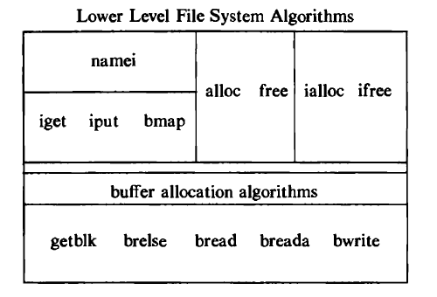

Slide 24
Review of inode
inode stands for index node.
In Unix based operating system each file is indexed by a number called inode(index node) or inode number.
It’s a name of a file in the form a number.
The inode contains the information necessary for a process to access a file, such as file ownership, access rights, file size, and location of the file's data in the file system.
inode contains the table of contents to locate a file's data on disk.
Also called as disk inode.

Slide 25
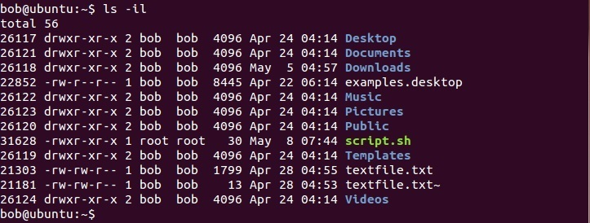
inode number can be viewed using the ls -il command

Slide 26
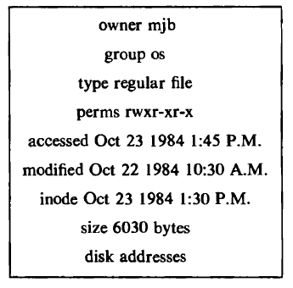
Disk inode of a Sample File

Slide 27
Concept of in-core inode
When the file is opened, then the kernel copies the inode(disk inode) into main memory area called inode cache, just likie the buffer cache.
So, this copy of disk inode present in MM is called as in-core inode.
As the file changes, the in-core inode is updated usually more often than the on-disk copy.
The in-core inode contains up-to-date information on the state of the file
This is allocation is done using iget algorithm

Slide 28
Accessing of inode
Accessing of inode is similar to the concept of accessing a buffer block in Buffer Cache.
Here also the concept Hash Queue and FREE LIST will be there.
The kernel maps the device number and inode number into a hash queue and searches the queue for the
inode.
If it cannot find the inode, it allocates one from the free list and locks it.
The kernel then prepares to read the disk copy of the newly accessed inode into the in-core copy.

Slide 29
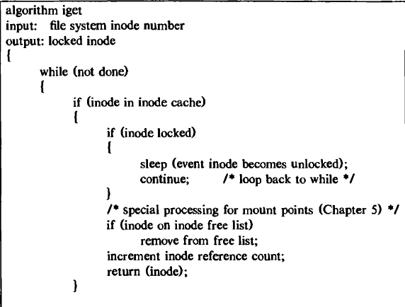
Allocation of an in-core copy of actual disk inode iget Algorithm

Slide 30
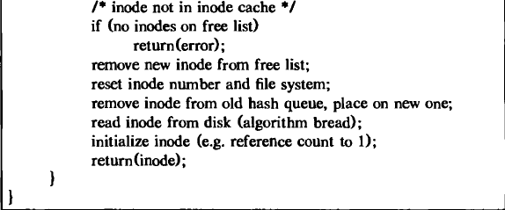
Allocation of an in-core copy of actual disk inode iget Algorithm

Slide 31
The kernel removes the in-core mode from the free list, places it on the correct hash queue, and sets its in-core reference count to 1.
It copies the file type, owner fields, permission settings, link count, file size, and the table of contents from the disk inode to the in-core inode, and returns a locked inode.

Slide 32
Releasing the inodes
When the kernel releases an inode ,it decrements its in-core reference count.
If the count drops to 0, the kernel writes the inode to disk if the in-core copy differs from the disk copy.
They differ if the file data has changed, if the file access time has changed, or if the file owner or access permissions have changed.
Now, the kernel places the inode on the free list of inodes, effectively caching the inode in case it is needed again soon.
The kernel may also release all data blocks associated with the file and free the inode if the number of links to the file is 0.

Slide 33
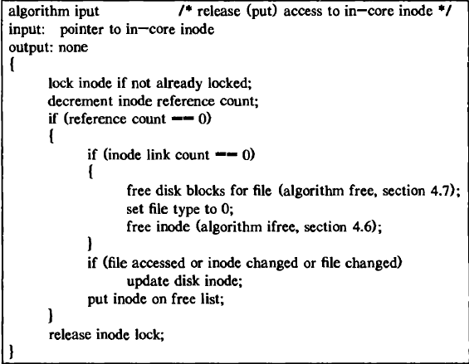
Releasing the inodes using iput algorithm

Slide 34
Directories
Directories are the set of files that gives the file system its hierarchical structure.
A directory is a file whose data is a sequence of entries, each consisting of an inode number and the name of a file contained in the directory.
A path name is a null terminated character string divided into separate components by the slash ("/") character.
Each component except the last must be the name of a directory, but the last component may be a non-directory file

Slide 35
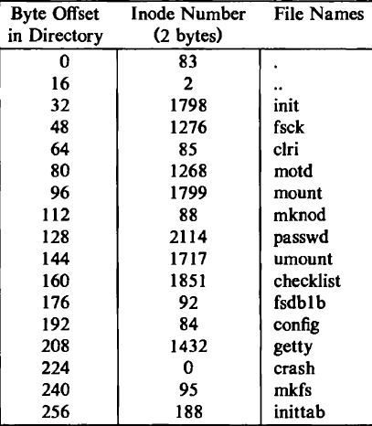
Directory layout for /etc

Slide 36
Directory entries may be empty, indicated by an mode number of 0.
For instance, the entry at address 224 in "/etc" is empty, although it once contained an entry for a file named "crash".

Slide 37
Every directory contains the file names dot and dot-dot ("." and "..") whose inode numbers are those of the directory and its parent directory, respectively.
The inode number of "." in "/etc“ is located at offset 0 in the file, and its value is 83.
The mode number of ".." is located at offset 16, and its value is 2.

Slide 38
Accessing a file in directory using path name
The access to a file in a directory is by its path name,
But the kernel works internally with inodes rather than with path names.
Therefore, it converts the path names to inodes to access files.
namei algorithm is used for Conversion of a Path Name to an mode.
It follows a pathname until a terminal point is found

Slide 39
namei Algorithm
The user ID of the process must match the owner or group ID of the file, and execute permission must be granted, or the file must allow search to all users.
Otherwise the search fails.

Slide 40
namei Algorithm
namei algorithm uses intermediate inodes as it parses a path name; call them working inodes.
The inode where the search starts is the first working mode.
During each iteration of the namei loop, the kernel makes sure that the working inode is indeed that of a directory.
Otherwise, the system would violate the assertion that non-directory files can only be leaf nodes of the file system tree.
The process must also have permission to search the directory (read permission is insufficient).

Slide 41
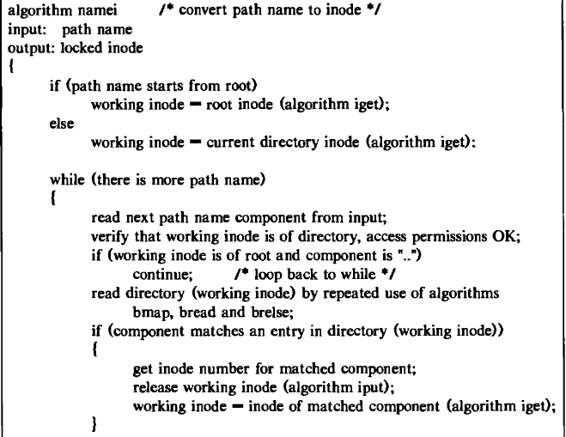
namei Algorithm

Slide 42
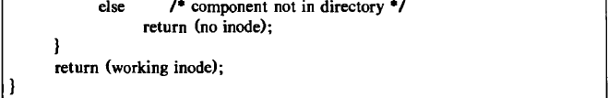
namei Algorithm

Slide 43
Text Book to be followed :
The Design of the UNIX Operating System
--Marice J.Bach

